Slide 1

Azure Fundamentals
UNIT- 5
Azure Services

Slide 2

Introduction
Azure SLA, which stands for Service Level Agreement, is a commitment made by Microsoft for the availability and uptime of its cloud services and resources within the Azure cloud platform. SLAs define the level of service that customers can expect and provide a guarantee of reliability for Azure services. Microsoft Azure offers SLAs for a wide range of its services, including virtual machines, databases, storage, networking, and more.

Slide 3
A service-level agreement (SLA) is a formal agreement between a service company and the customer. For Azure, this agreement defines the performance standards that Microsoft commits to for you, the customer.
Here’s a table to give you a sense of how total downtime decreases as the SLA percentage increases from 99 percent to 99.999 percent:
What are service credits?
A service credit is the percentage of the fees you paid that are credited back to you according to the claim approval process.
An SLA describes how Microsoft responds when an Azure service fails to perform to its specification. For example, you might receive a discount on your Azure bill as compensation when a service fails to perform according to its SLA.
Free products typically don’t have an SLA.
Azure status provides a global view of the health of Azure services and regions. If you suspect there’s an outage, this is often a good place to start your investigation.
SLA percentage | Downtime per week | Downtime per month | Downtime per year
99 | 1.68 hours | 7.2 hours | 3.65 days
99.9 | 10.1 minutes | 43.2 minutes | 8.76 hours
99.95 | 5 minutes | 21.6 minutes | 4.38 hours
99.99 | 1.01 minutes | 4.32 minutes | 52.56 minutes
99.999 | 6 seconds | 25.9 seconds | 5.26 minutes

Slide 4
Azure Service Level Agreements
Availability Commitment: Azure SLAs specify the minimum level of availability that Microsoft guarantees for a particular service. This is usually expressed as a percentage of uptime over a given time period, such as 99.9% uptime per month.
Downtime Allowance: Azure SLAs also define the allowable downtime for a service. If the service experiences more downtime than the SLA allows, customers may be eligible for service credits.
Service Credits: In the event that Azure services do not meet their SLA commitments, Microsoft may provide customers with service credits. These credits can be used to offset future Azure service charges
Service-Specific SLAs: Different Azure services may have different SLAs. For example, Azure Virtual Machines may have a different SLA compared to Azure SQL Database or Azure Blob Storage. Customers should review the SLA for each specific service they are using.

Slide 5
Azure Service Level Agreements
Exclusions: SLAs often have certain exclusions or exceptions. These are situations where downtime is not counted against the SLA, such as planned maintenance or customer-initiated actions.
Monitoring and Reporting: Azure actively monitors the health of its services, and customers can access service health status information through the Azure portal. This transparency helps customers track the performance and availability of their resources.
Azure's SLAs provide a level of assurance regarding the reliability of the platform, but they also require customers to configure the resources in a way that maximum availability, such as deploying the resources across multiple regions for redundancy

Slide 6
SLAs for Azure Products and Services
Performance targets are expressed as uptime and connectivity guarantees.
Performance-targets range from 99.9% (three nines) to 99.99% (four nines).
If a service fails to meet the guarantees, a percentage of the monthly service fees can be credited to you.
SLAs define Microsoft’s commitment to an Azure service or product.
Individual SLAs are available for each Azure product and service.
SLAs also define what happens if a service or product fails to meet the designated availability commitments.

Slide 7
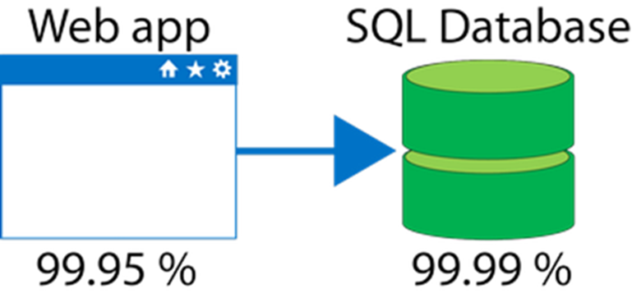
Composite SLAs
The process of combining SLAs helps you compute the composite SLA for a set of services. Computing the composite SLA requires that you multiply the SLA of each individual service.
If the App Service has a 99.95% SLA, and the Azure SQL Database has a 99.99% SLA, what is the composite SLA for your application?
Composite SLA
9995 * .9999
= 99.94%
Notice the composite SLA is lower than the individual SLAs.
Improve the SLA by creating independent fallback paths

Slide 8
Application SLAs
Customers should determine what SLA is needed for their application.
Know your workload requirements and usage patterns.
Design for resiliency and availability.
Establish availability metrics — mean time to recovery (MTTR) and mean time between failures (MTBF).
Establish recovery metrics — recovery time objective and recovery point objective (RPO).
Implement resiliency strategies.
Build in availability requirements

Slide 9
Azure VM SLA
Additional Definitions:
“Availability Set” refers to two or more Virtual Machines deployed across different Fault Domains to avoid a single point of failure.
“Availability Zone” is a fault-isolated area within an Azure region, providing redundant power, cooling, and networking.
"Azure Dedicated Host" provides physical servers that host one or more Azure virtual machines with the (default) setting of autoReplaceOnFailure required for any SLA.
“Data Disk” is a persistent virtual hard disk, attached to a Virtual Machine, used to store application data.
"Dedicated Host Group" is a collection of Azure Dedicated Hosts deployed within an Azure region across different Fault Domains to avoid a single point of failure.

Slide 10
Azure VM SLA
Fault Domain” is a collection of servers that share common resources such as power and network connectivity.
“Operating System Disk” is a persistent virtual hard disk, attached to a Virtual Machine, used to store the Virtual Machine’s operating system.
“Single Instance” is defined as any single Microsoft Azure Virtual Machine that either is not deployed in an Availability Set or has only one instance deployed in an Availability Set.
“Virtual Machine” refers to persistent instance types that can be deployed individually or as part of an Availability Set or using a Dedicated Host Group. A virtual machine can be deployed in a multi-tenant environment in Azure or in an isolated, single-tenant environment using Azure Dedicated Hosts.

Slide 11
Azure VM SLA
Virtual Machine Connectivity” is bi-directional network traffic between the Virtual Machine and other IP addresses using TCP or UDP network protocols in which the Virtual Machine is configured for allowed traffic. The IP addresses can be IP addresses in the same Cloud Service as the Virtual Machine, IP addresses within the same virtual network as the Virtual Machine or public, routable IP addresses.
Uptime Calculation and Service Levels for Virtual Machines in Availability Zones
“Maximum Available Minutes” is the total accumulated minutes during an Applicable Period that have two or more instances deployed across two or more Availability Zones in the same region. Maximum Available Minutes is measured from when at least two Virtual Machines across two Availability Zones in the same region have both been started resultant from action initiated by Customer to the time Customer has initiated an action that would result in stopping or deleting the Virtual Machines.
“Downtime” is the total accumulated minutes that are part of Maximum Available Minutes that have no Virtual Machine Connectivity in the region

Slide 12
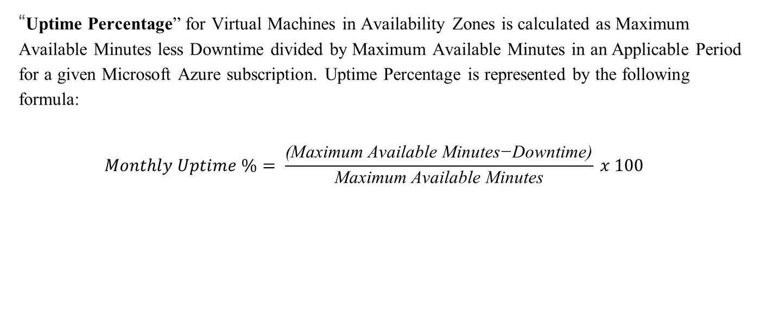
Azure VM SLA
“Uptime Percentage” for Virtual Machines in Availability Zones is calculated as Maximum Available Minutes less Downtime divided by Maximum Available Minutes in an Applicable Period for a given Microsoft Azure subscription. Uptime Percentage is represented by the following formula:
$$Monthly Uptime \%= \frac{\text{(}\text{Maximum} \text{Available} \text{Minutes}\text{−}\text{Downtime}\text{)}}{\text{Maximum} \text{Available} \text{Minutes}} x 100$$

Slide 13
Azure Compute Services
Service Credit:
The following Service Levels and Service Credits are applicable to Customer’s use of Virtual Machines deployed across two or more Availability Zones in the same region
Uptime Percentage | Service Credit
< 99.9% | 10%
< 99% | 25%
< 95% | 100%

Slide 14
Azure VM SLA
Uptime Calculation and Service Levels for Virtual Machines in an Availability Set or in the same Dedicated Host Group
Maximum Available Minutes: The total accumulated minutes during an Applicable Period for all Internet facing Virtual Machines that have two or more instances deployed in the same Availability Set on in the same Dedicated Host Group. Maximum Available Minutes is measured from when at least two Virtual Machines in the same Availability Set, or same Dedicated Host Group, have both been started resultant from action initiated by you to the time you have initiated an action that would result in stopping or deleting the Virtual Machines.
Downtime: The total accumulated minutes that are part of Maximum Available Minutes that have no Virtual Machine Connectivity.

Slide 15

Azure VM SLA
Uptime Percentage: for Virtual Machines is calculated as Maximum Available Minutes less Downtime divided by Maximum Available Minutes in an Applicable Period for a given Microsoft Azure subscription. Uptime Percentage is represented by the following formula:
$$Monthly Uptime \%= \frac{\text{(}\text{Maximum} \text{Available} \text{Minutes}\text{−}\text{Downtime}\text{)}}{\text{Maximum} \text{Available} \text{Minutes}} x 100$$

Slide 16
Azure Service Level Agreements
Microsoft Azure offers Service Level Agreements (SLAs) for various Azure services to provide customers with a guarantee of service availability and reliability. These SLAs specify the level of uptime and performance that customers can expect from Azure services and offer compensation in the event of service downtime or unavailability beyond the defined thresholds. Here are some key Azure services with their corresponding SLAs:
Azure Virtual Machines (VMs):
SLA: 99.95% monthly virtual machine uptime.
This SLA guarantees that virtual machines deployed in Azure will be available at least 99.95% of the time in a given month.
Azure SQL Database:
SLA: 99.99% availability for the premium tier and 99.95% for the basic and standard tiers.
Different service tiers have different availability guarantees.
Azure Blob Storage:
SLA: 99.9% availability for read-access geo-redundant storage (RA-GRS).
Azure Blob Storage offers redundancy options, and the SLA can vary depending on the redundancy type chosen

Slide 17
Azure Service Level Agreements
4. Azure App Service:
SLA: 99.95% uptime for the App Service Environment.
App Service provides a platform for hosting web applications, mobile app backends, and RESTful APIs.
5. Azure Functions:
SLA: 99.95% uptime for the Azure Functions Premium plan.
The Azure Functions SLA guarantees high availability for serverless compute resources.
6. Azure Kubernetes Service (AKS):
SLA: 99.95% uptime for the control plane.
The control plane is the management layer of AKS, ensuring the availability of the Kubernetes API server and other essential components.
7. Azure Cosmos DB:
SLA: Varies depending on the consistency level chosen, with the highest being 99.999% availability for the single-region write (eventual consistency) option.
Azure Cosmos DB provides a globally distributed, multi-model database service.

Slide 18
Azure Service Level Agreements
8. Azure Active Directory (Azure AD):
SLA: 99.9% availability for the Azure AD Basic and Premium service plans.
Azure AD is Microsoft's cloud-based identity and access management service.
9. Azure Key Vault:
SLA: 99.9% availability for the Azure Key Vault service.
Azure Key Vault is a secure secrets and keys management service.
10. Azure Logic Apps:
SLA: 99.9% availability for the Azure Logic Apps service.
Azure Logic Apps allows you to automate workflows and integrate various services and applications.
It's important to note that SLAs typically have certain conditions, exclusions, and limitations. Downtime caused by factors outside of Microsoft's control, such as customer misconfigurations or force majeure events, may not be covered by the SLA. Additionally, SLAs may provide service credits to customers if the guaranteed uptime is not met.

Slide 19
Azure Service Lifecycle
Azure service lifecycles refer to the various stages that a Microsoft Azure service goes through from its initial development and introduction to its eventual retirement or replacement. Understanding the lifecycle of Azure services is important for Azure customers and administrators because it helps them plan for service adoption, updates, and eventual transitions to newer services. Here are the typical stages in the lifecycle of an Azure service:
Development and Introduction:
Development Phase: Microsoft Azure services are initially conceived, designed, and developed by Microsoft's engineering teams. During this phase, the service is created and undergoes extensive testing and quality assurance.
Introduction: Once development is complete, the service is introduced to the Azure platform and made available to customers. This marks the beginning of its public lifecycle.
General Availability (GA):
GA Phase: This is the stage where the service is generally available to all Azure customers. It is considered mature and stable, and Microsoft provides support and SLAs for the service. Customers can start using it for production workloads.

Slide 20
Azure Service Lifecycle
3. Updates and Enhancements:
Active Development: Azure services continue to receive updates, enhancements, and new features to meet evolving customer needs and to address security and performance issues. These updates may include bug fixes, performance improvements, and new functionality.
4. Retirement and Deprecation:
Deprecation Notice: Over time, Azure services may become outdated or redundant due to technology advancements or shifts in customer requirements. Microsoft typically provides advance notice (often several months to years) to customers about the deprecation of a service. During this period, customers are encouraged to plan for migration to alternative services.
End of Life (EOL): After the deprecation period, the service is officially retired, and Microsoft may no longer provide support or updates for it. Customers are strongly advised to migrate their workloads to supported alternatives to avoid disruptions.

Slide 21
Azure Service Lifecycle
5. Migration and Transition:
Migration Assistance: Microsoft often provides tools, documentation, and guidance to help customers migrate from deprecated services to newer ones or to re-architect their applications.
Service Continuity: Customers are responsible for ensuring the continuity of their services during migration. This may involve modifying configurations, updating code, and testing.
6. Replacement and Successor Services:
In some cases, Microsoft may introduce new services that replace or offer similar functionality to deprecated services. Customers can consider adopting these successor services for their workloads.
7. Archive and Historical Data:
Customers may need to plan for the archival and retention of historical data and resources associated with retired services, as access to these resources may no longer be available through the Azure portal.
It's crucial for Azure customers to stay informed about the lifecycle status of the services they rely on and to proactively plan for changes, especially when services are deprecated.
.

Slide 22
Thank You.

